Slide 1
Restaurant Management
Team Gigabyte

Slide 2
Project Introduction
Restaurant Management System includes admin and staff. In this system,
It's intended to assist admin and staff in carrying out the most critical managerial tasks.
can know order list detail, workforce management, stock balance.

Slide 3
Admin Role
In admin role,
can create food List
can view, update and delete all food list data
can view, create, update and delete staff list data
can view order list and detail order

Slide 4
Staff Role
In staff role,
can view food items and category
can order by choosing food items
can checkout order after confirming
can view profile and change password
can view order list by staff ID

Slide 5
Project flow
Backend
Java
Spring Boot
Frontend
VueJs
Database
Git
GitHub
Postman
Other Technologies
MySQL

Slide 6
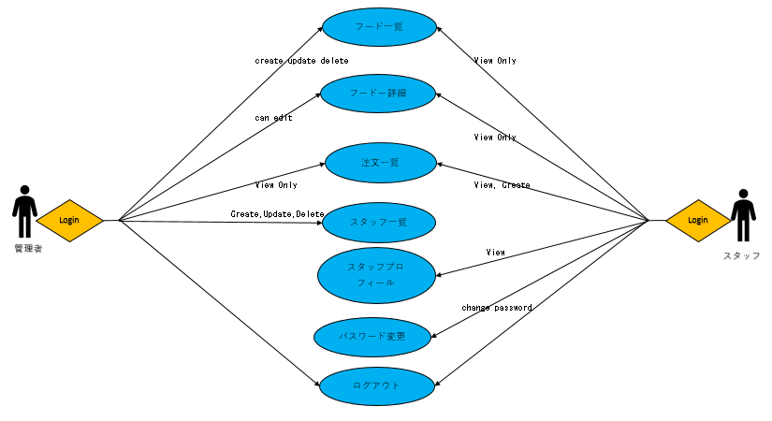
Project flow

Slide 7
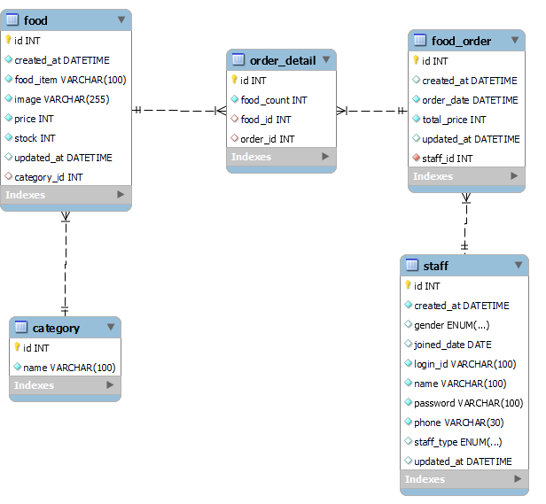
ER Diagram

Slide 8
Team Members
Khant Kyi Thar
Aye Moh Moh Win
Khine Phyu Phyu Win

Slide 9
Project Show
http://localhost:8080/
Github Repo
https://github.com/KhantKyiThar/online_restaurant_management

Slide 10
Thank You

